Slide 1


ELK Stack Project
By: the Caribou Pancakes, 2/7/22

Slide 2

Introduction
Objectives - Layla
Hurdles (mini walk through) - Rodney
Awesome shit we did to overcome the hurdles - Rodney
Other Hurdles - Hisoka
Why they were hurdles and not anymore - Hisoka
Where we are now - Beverly
What you have left to look forward to - Patrick
Successes and Learnings

Slide 3

Project To-Do List
Create a new peer connected vNet and VM
Make John proud
Download/configure containers, playbooks, filebeat, metricbeat
Have fun… or cry trying!
Create inbound rules for VM network security group
Ask for mercy from the CIA triad
Search Elasticsearch using Kibana for logs

Slide 4

Day 1: Azure Squid Games
Where is the everything?!
Navigating struggles
Virtual Network
same resource group
NEW region
Peer Connection
allow traffic to pass in both directions
Virtual Machine
Ubuntu configurations
Static IPs!

Slide 5

Day 1: Club Ubuntu : All Access Pass
Public Keys
triple -dipping (VMs and containers)
Can you ping me now? Good!
Connect VM to Ubuntu using ssh command
Configurations
Ansible hosts
Install Elk and Docker playbooks
Kibana Boy
Start elk server
Allow access to 5601 port
http://[your.ELK-VM.External.IP]:5601/app/kibana

Slide 6

Hurdles, Hurdles, and *look over there* More Hurdles!!!!
SSH Key
Having to constantly create a new SSH Key.
Resetting password key to assure it matched on all VMs.
Ansible Container
Container each time command to run docker was ran.
Figuring out how to get back on to the same ansible container.
Elk Playbook
Spacing & spelling errors!
Notes:
Get back on same ansible container using docker container list -a, find your containers name and use command docker start [container name]. Command to run docker is docker run -it cyberxsecurity/ansible /bin/bash. Tells you that you can’t use tab to

Slide 7

Day 2: FileBeats by John / Metricbeat Installation
Install FIlebeat
Configure Filebeat
Make Filebeat playbook
Verify
Metricbeat, rinse, watch repeat.

Slide 8
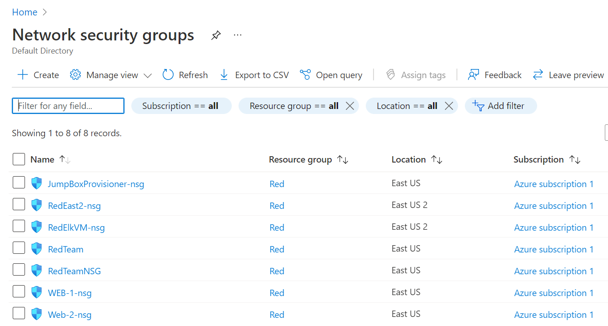
NETWORK SECURITY GROUP

Slide 9
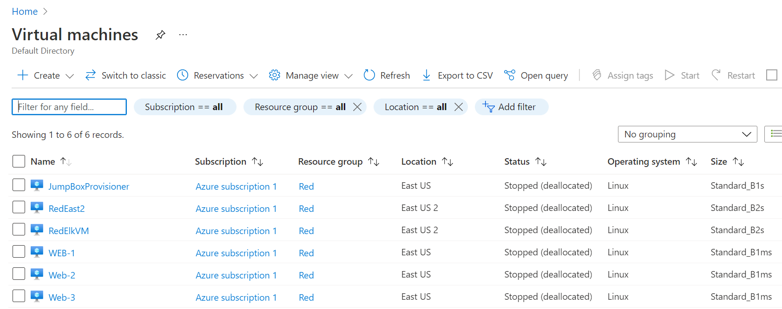
Virtual Machines

Slide 10
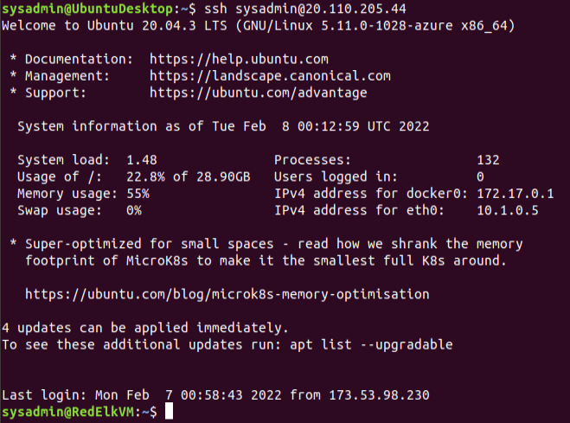
SSH INTO ELK

Slide 11
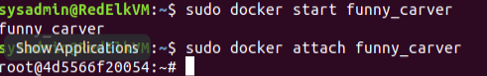
START AND ATTACH CONTAINER

Slide 12
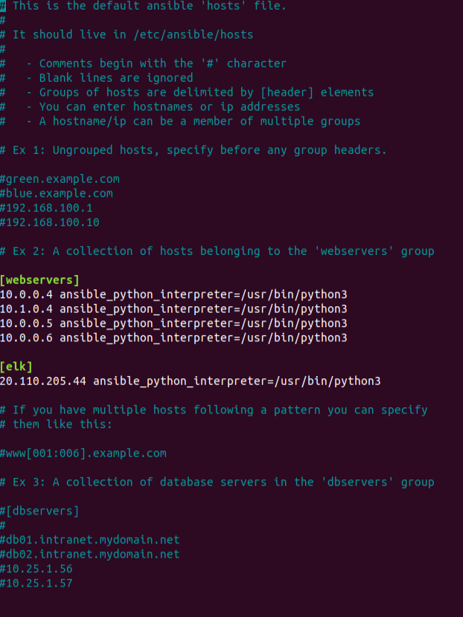
NANO HOSTS UPDATE WEBSERVERS ADD ELK

Slide 13
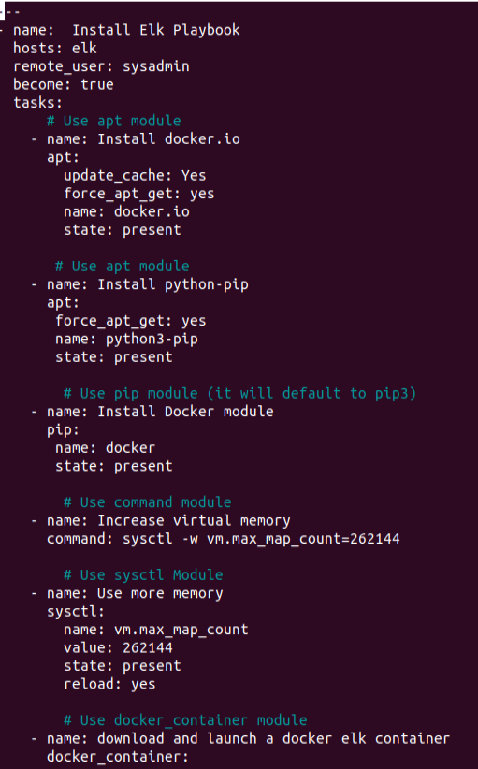
Install -elk.yml

Slide 14
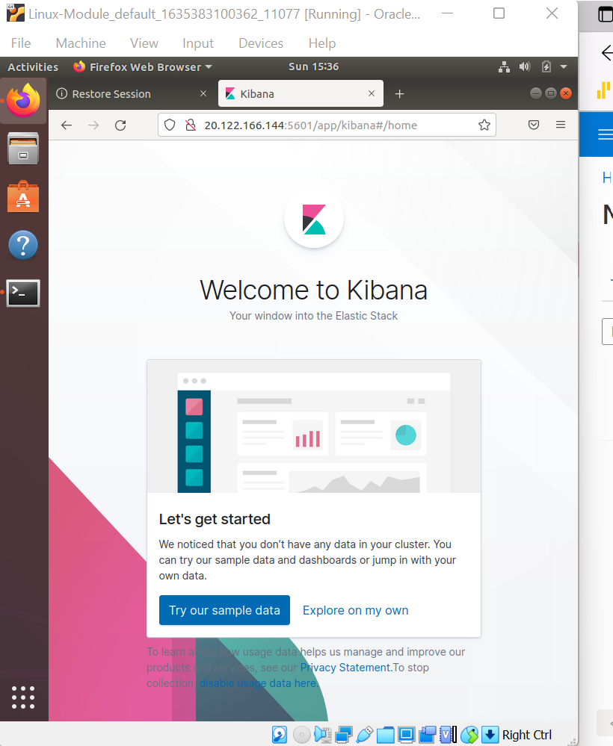
Where we are now.
Although it took us hours to troubleshoot, as we encountered several errors to get the Kibana website to work even after troubleshooting, some of us were still unsuccessful, however as a group we have successfully completed the project for day 1, and successfully installed Filebeat.

Slide 15
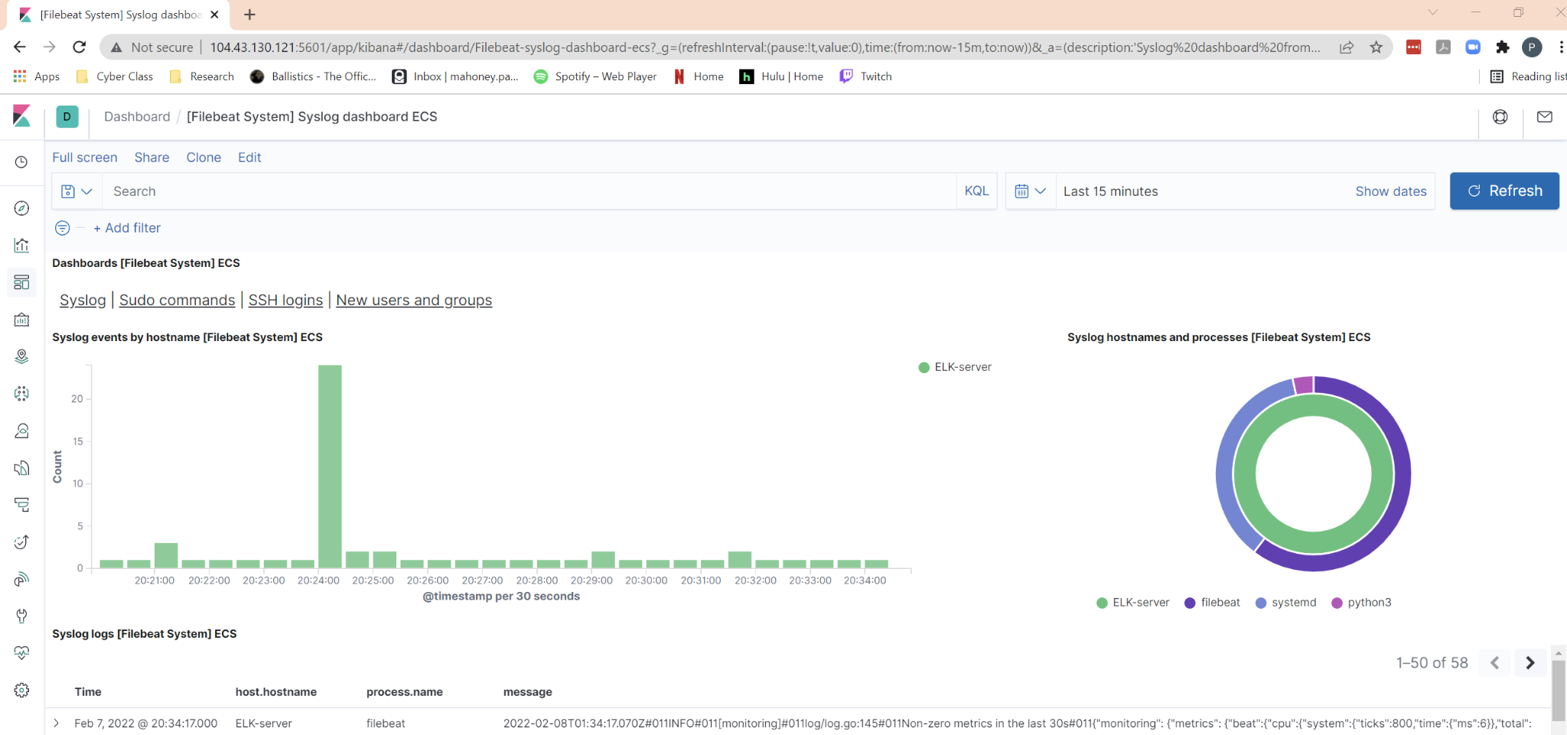
Filebeat beating the files

Slide 16
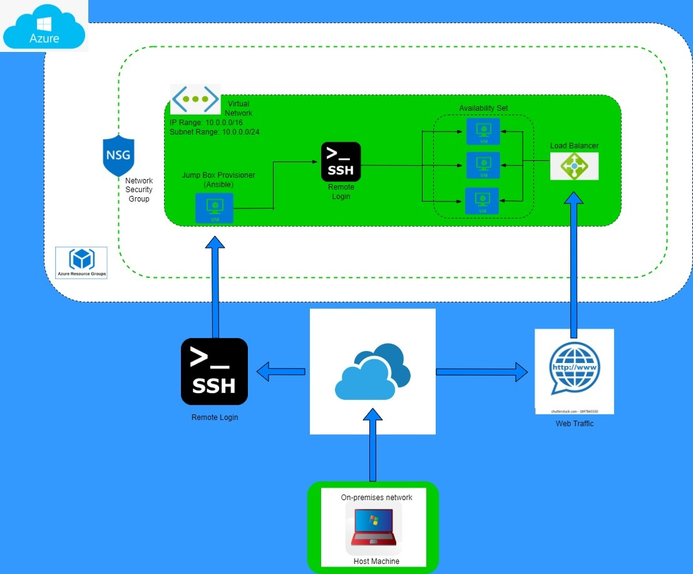
Azure Network Pre-ELK

Slide 17
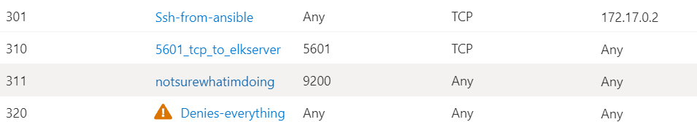
Security Rules for Elk Server Security Group

Slide 18
What’s next
Install Metricbeat (all new playbook!)
Figure out how to connect our Web1 and Web2 VM’s to send logs
Ensure security groups are actually secure

Slide 19
What we learned
A VM’s IP address will change when it’s restarted (affects yml files referencing specific IP’s, network security rules, SSH)
Network security rules are not as secure as they could be

Slide 21
What its like to edit a yaml file
https://www.youtube.com/watch?v=Jb9Ebe_rA8M

